Slide 1

0
-2
3
X’s turn:
-2
0
0
1

Slide 2







O’s turn:
X’s turn:

Slide 3

Plays the move that results in the maximum value:
Utility = (winning state + empty spots)* 1
O’s turn:
A
B
Plays the move that results in the minimum value:
Utility = (winning state + empty spots) * -1
0
0
1
X’s turn:
Utility = (winning state + empty spots)* 1

Slide 4
Plays the move that results in the maximum value:
Utility = (winning state + empty spots)* 1
-2
0
0
1
O’s turn:
Plays the move that results in the minimum value:
Utility = (winning state + empty spots) * -1
0
0
1
X’s turn:
Utility = (winning state + empty spots)* 1

Slide 5
Plays the move that results in the maximum value:
0
-2
3
Utility = (winning state + empty spots)* 1
-2
0
0
1
O’s turn:
Plays the move that results in the minimum value:
Utility = (winning state + empty spots) * -1
0
0
1
X’s turn:
Utility = (winning state + empty spots)* 1

Slide 6
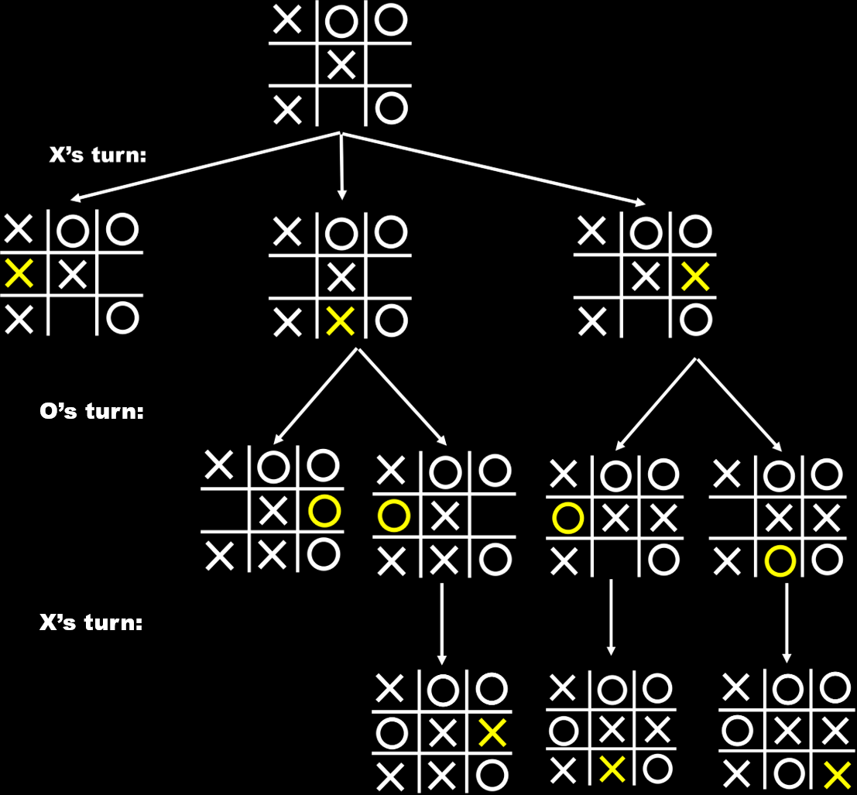

Slide 7
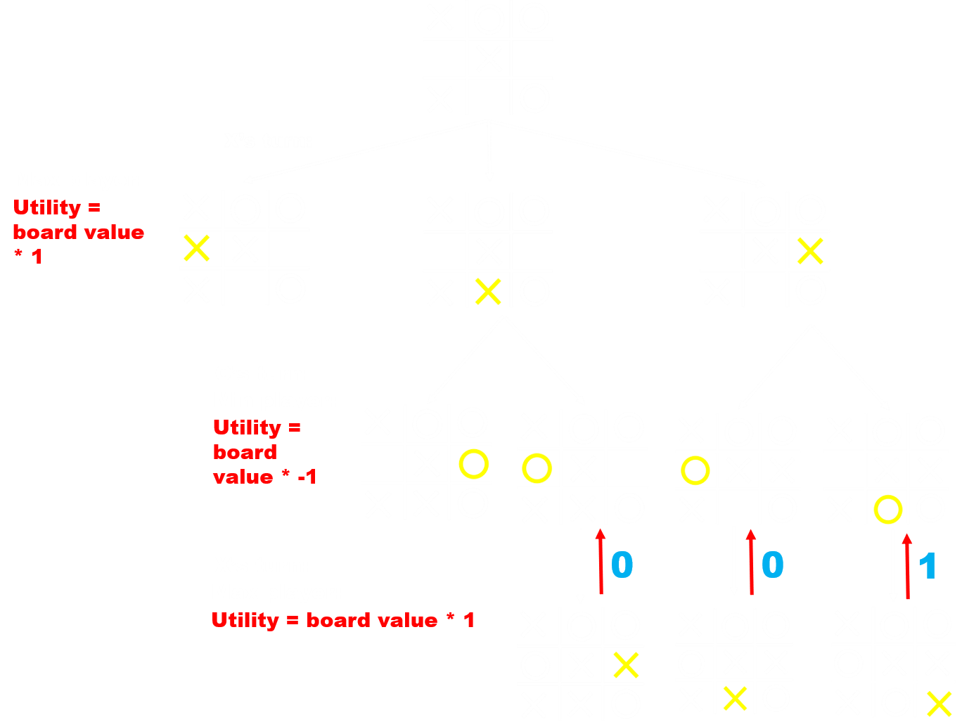

Slide 8
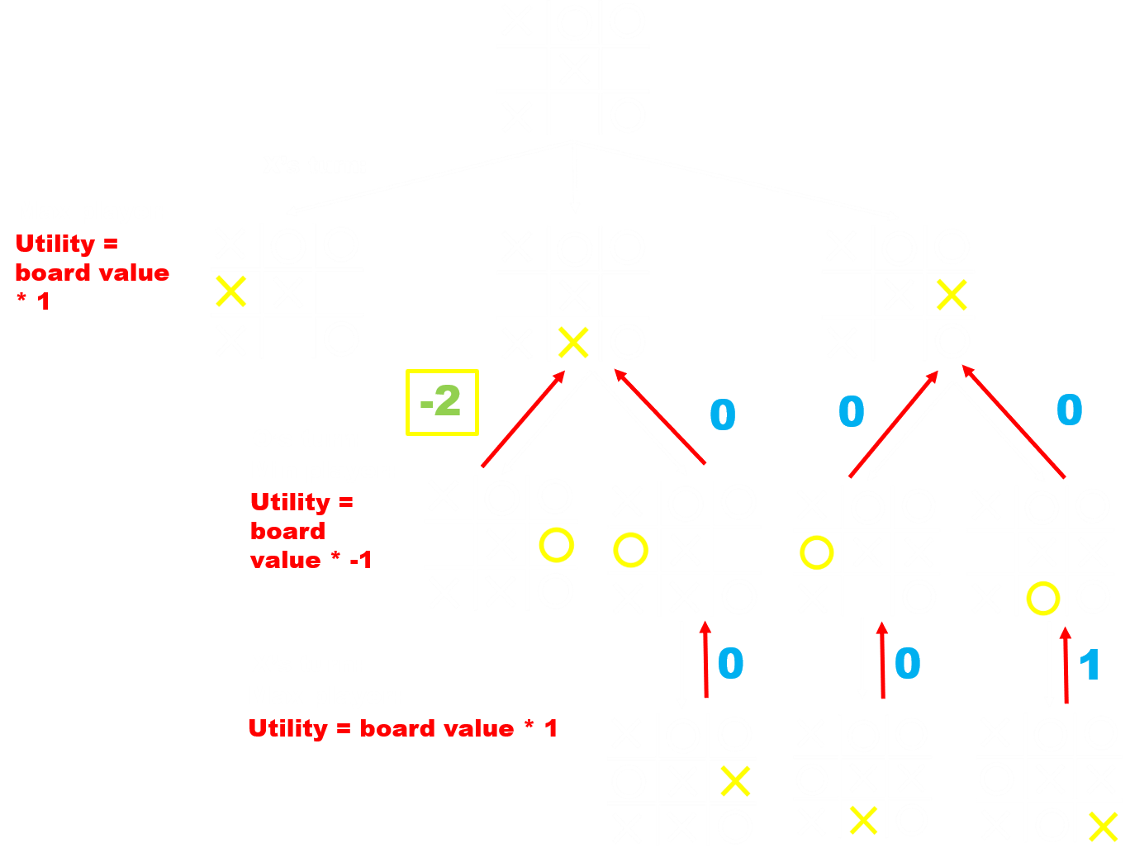

Slide 9
